Slide 1

MID-TERM PROJECT
GROUP 6
Chau Trinh, Eirlys Vo, and Sandy Chun Domingo

Slide 2
Introduction
Business Problem/Question
How do the promotions in different display/ mail locations (ex: in store, mailer) impact customer purchase behavior?
Customers are more likely to redeem coupons when products are featured on the interior pages of mailers.
A stacked bar plot illustrates total sales across different mailer locations and departments, highlighting the impact of coupon placement.
The percentage-based analysis shows the contribution of each department to total sales, identifying which departments benefit most from interior page displays.

Slide 3
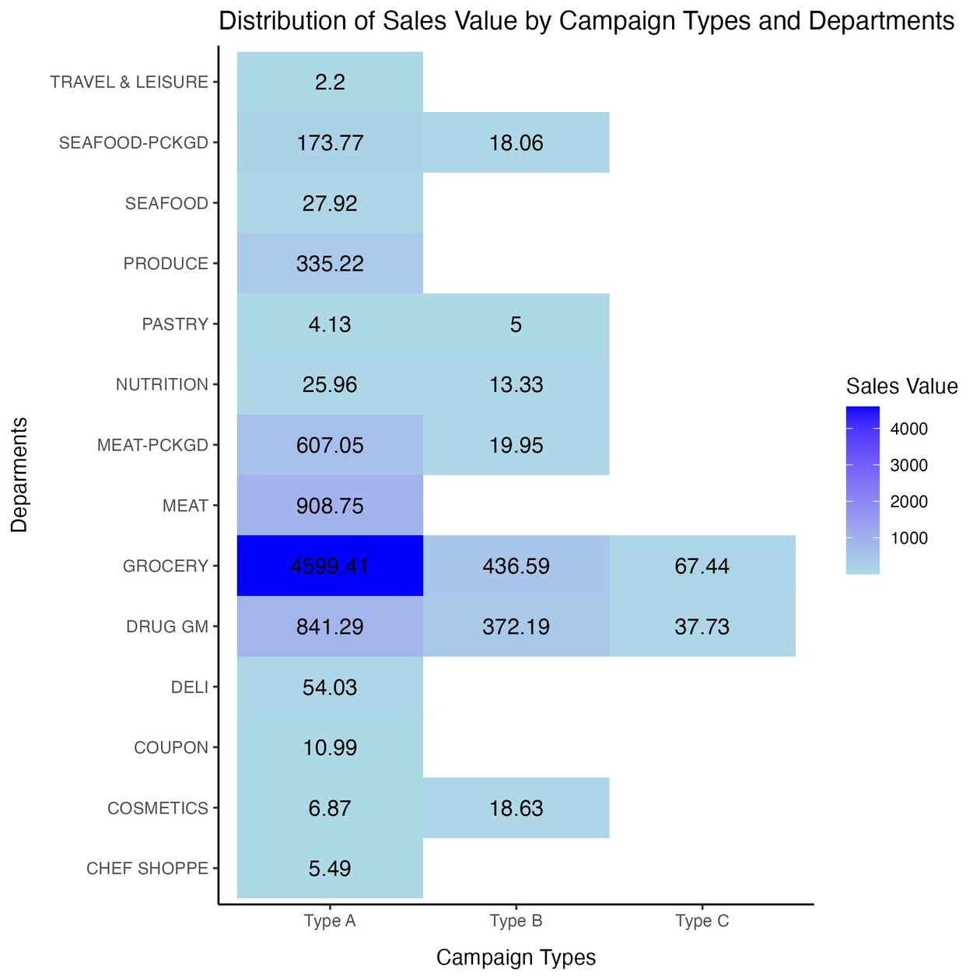
Coupon types effect on sales
Analysis Overview
Investigated coupon campaign types' effects on redemption counts and total sales.
Key Findings
Campaign Type A:
Outperformed others in both redemption counts and sales value.
Requires further analysis on:
Best-suited products
Success factors (discounts, placement)
Sales Distribution Insights
Grocery Department:
Led in sales across all campaign types due to essential nature.
Type A Campaign:
Highly effective; potential strategies to enhance underperforming departments.
Notes:
Analysis Overview:
Investigated the impact of various coupon campaign types on consumer behavior, focusing on redemption counts and total sales.
Key Findings from First Graph:
Campaign Type A outperformed others in both redemption count and sales value, indicating strong customer engagement.
Insights for Campaign Type A:
Further investigation needed into:
Products best suited for Campaign Type A
Structural elements contributing to its success (e.g., attractive discounts, effective placement).
Sales Distribution Insights:
Grocery Department led in sales across all campaign types due to essential product nature.
Type A campaign demonstrated high effectiveness, suggesting potential strategies to enhance underperforming departments.

Slide 4
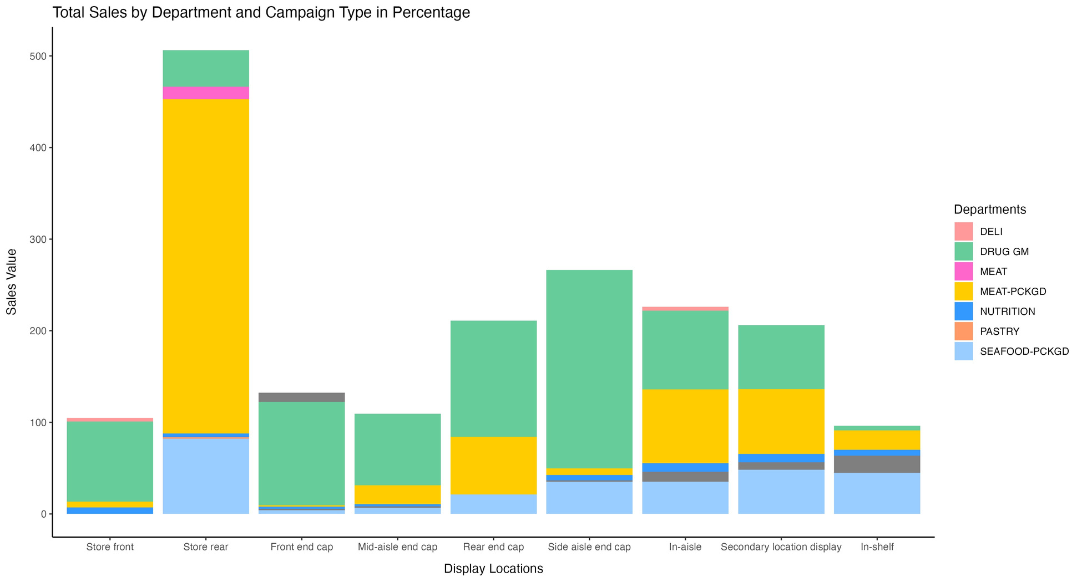
Display location analysis
Key Findings
Sales Plot: Shows raw values by department (excluding Grocery).
Top Performers:
Drug GM had the highest sales, followed by Meat Packaged, indicating that coupons boost purchases.
Normalized Sales Analysis
Sales Percentages:
Drug GM led even without coupons; Meat Packaged dropped significantly when not displayed.
Conclusion
Display Impact:
Locations greatly influence sales, especially for packaged goods.
Notes:
Hypothesis Overview:
Analyzing the impact of display locations and coupons on product purchases.
Key Findings:
Stacked Bar Plot: Displays raw sales values across departments (excluding Grocery).
Top Performers: Drug GM had the highest sales, followed by Meat Packaged and Seafood Packaged, indicating that coupon offers boost purchases in selected categories.
Normalized Sales Analysis:
Normalized sales into percentages for clearer comparisons:
Drug GM continued to dominate sales even without coupon offerings.
Notably, Meat Packaged experienced a sharp decline in sales when not displayed.
Conclusion:
Display location significantly influences sales, especially for packaged goods.
Consistent performance from Drug GM and Meat Packaged highlights the importance of strategic display placements.

Slide 5
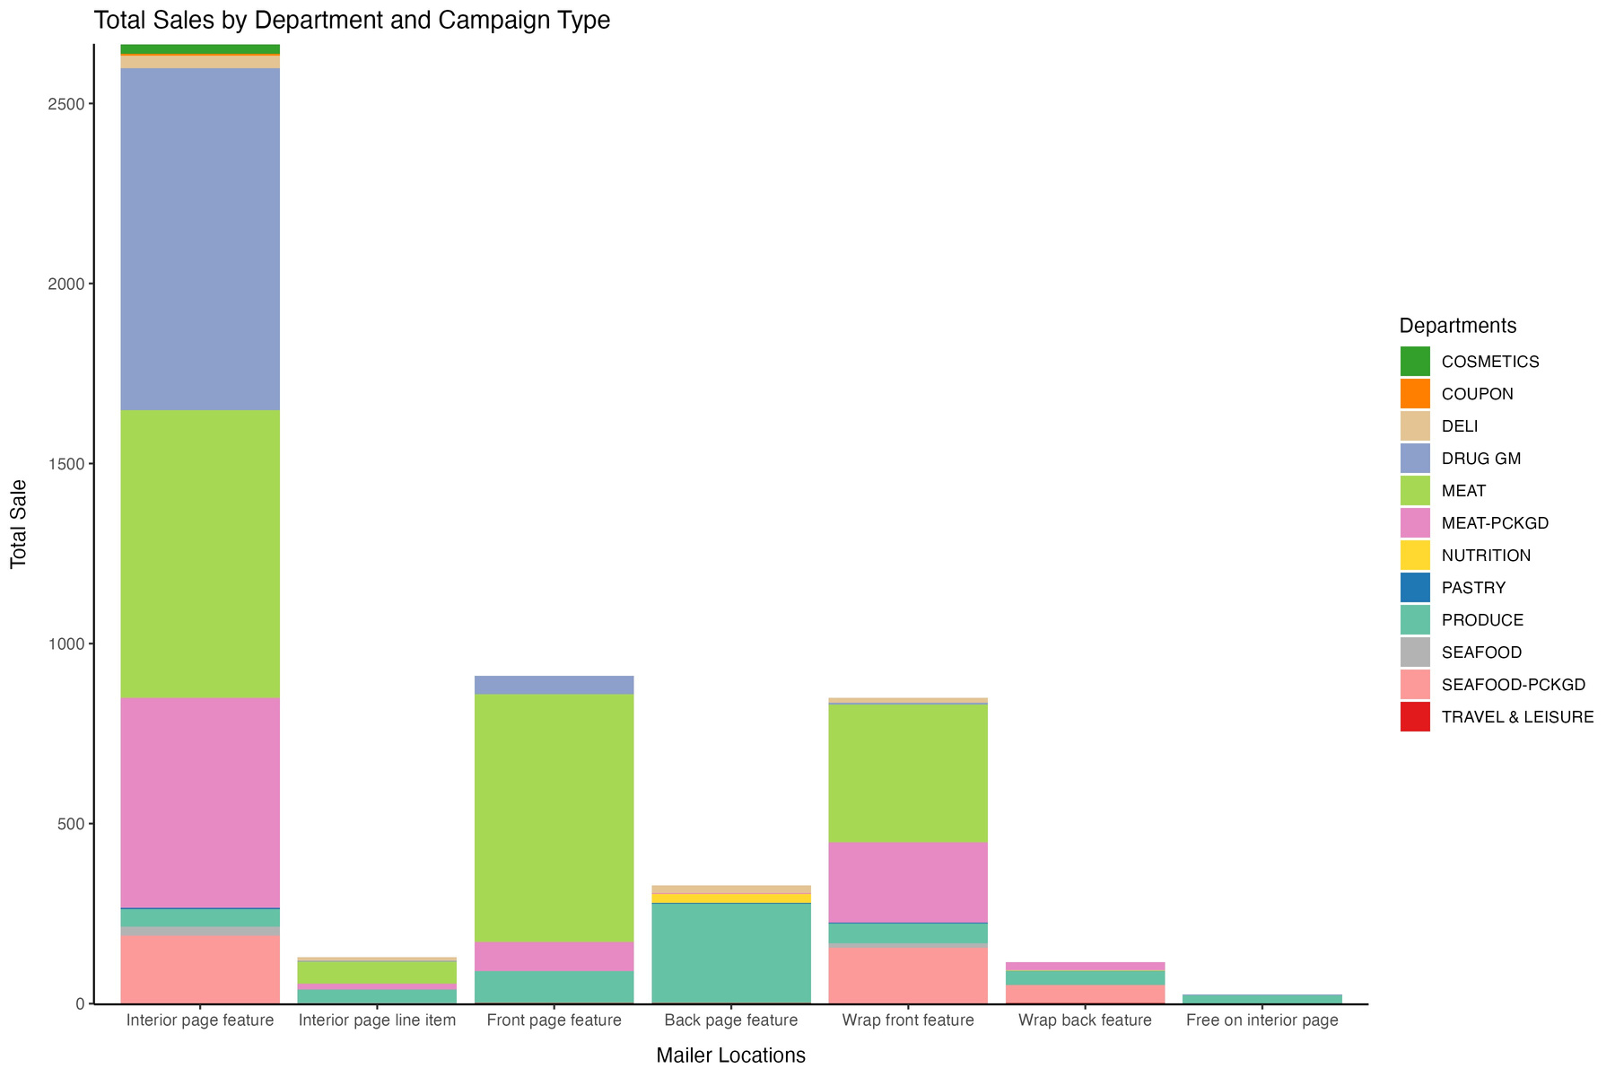
Impact of Mailer Locations on Coupon Redemption.
Hypothesis
Customers are more likely to redeem coupons for products on the interior pages of mailers.
Key Findings
Top Sales Locations:
Location A excels in Grocery sales; Drug GM and Meat departments perform strongly.
Visual Insights:
Stacked bar plot shows total sales by department, with Drug GM and Meat-PCKGD excelling in coupon placements.
Conclusion
Strategic placement in mailers boosts coupon redemption rates.

Slide 6
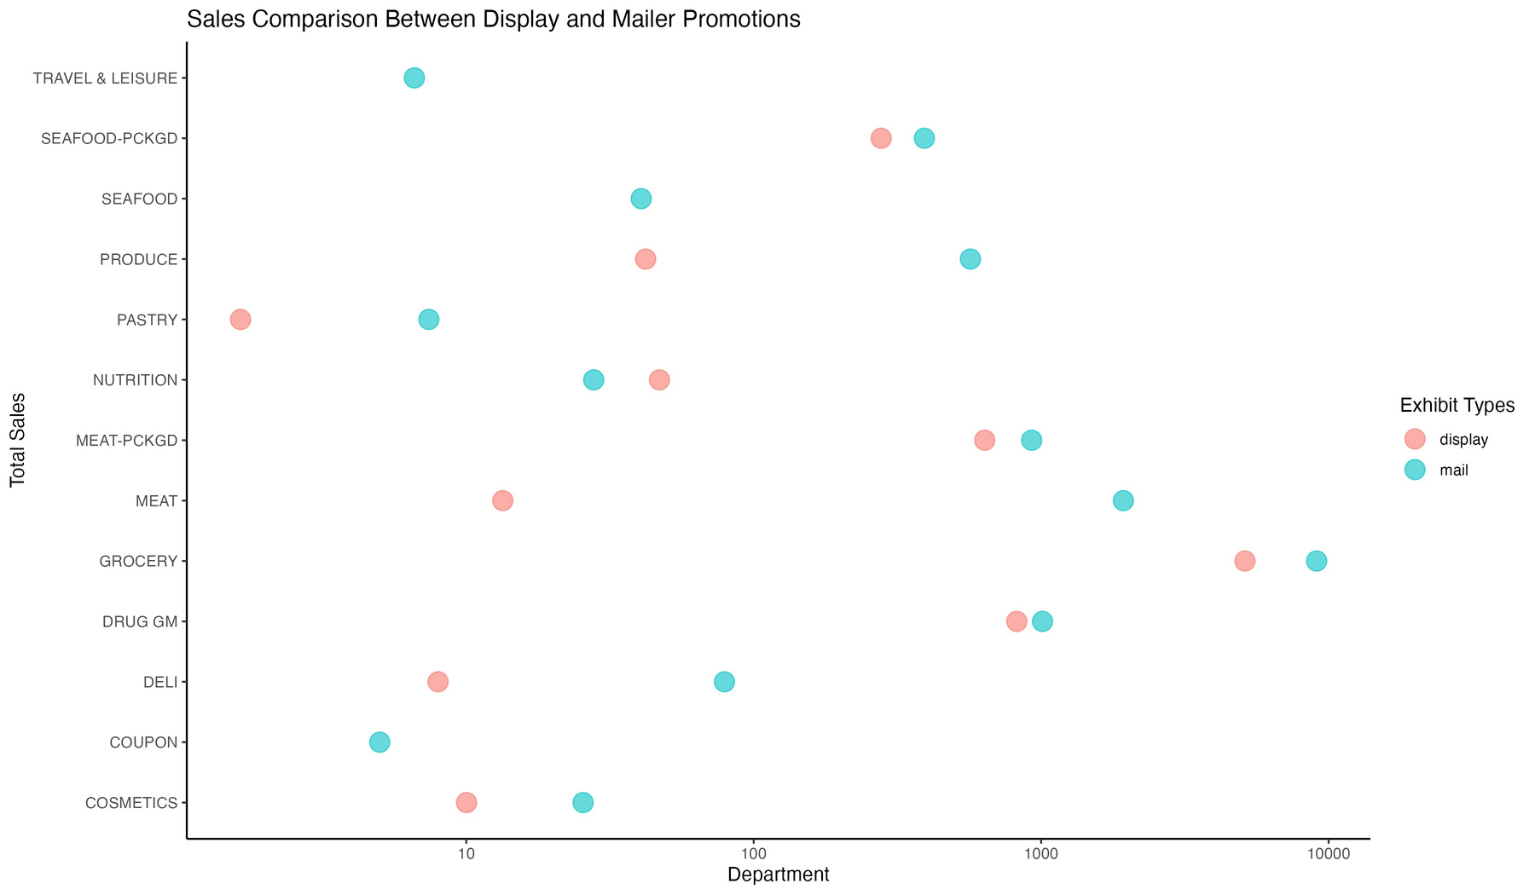
Display vs. Mailer promotion
Hypothesis:
Analyzing sales impact of mailer vs. display promotions.
Data Overview:
Total sales summarized by department for both promotions.
Key Findings:
Display promotions drive higher sales overall.
Mailer promotions perform well in specific categories.
Visual Insights:
Scatter plot shows sales comparison using a logarithmic scale.
Conclusion: Effective promotional strategies boost sales across departments.

Slide 7
Summary
Analyzed coupon campaigns, display locations, and mailer promotions.
Key findings:
Campaign Type A boosted sales and engagement.
Grocery Department performed well; others need improvement.
Display locations significantly impact sales.
Recommendations
Enhance Campaign Type A for underperforming departments.
Optimize display placements for visibility and sales.
Leverage targeted mailers for high-potential departments.
Continue analysis to refine marketing strategies.

